Slide 1
Final Project: Boids
CSCI x810 Computer Graphics Final Project
Jorrin Thacker

Slide 2
Milestone 1 (Complete)
Project Setup
Custom Shaders
Simple Boid Logic (Movement, Rotation)
Wall Boundaries

Slide 3
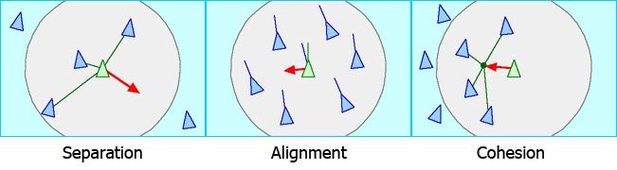
Milestone 2 (Complete)
Implement Boid Rules (Separation, Alignment, Cohesion)
Add collision detection for boids (Walls, Objects)
Create Boid Playground with many objects to navigate (cubes, Spheres, Torus, etc.)

Slide 4
Milestone 3 (Complete)
Add controls to change aspects of Boids
Add additional Rules (Leadership, Swarms/Racism, etc.)
Use a better Model for the boids

Slide 5
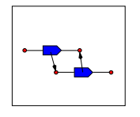
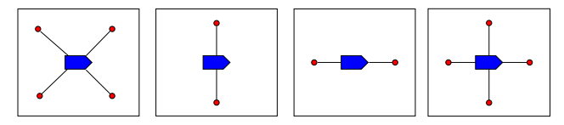
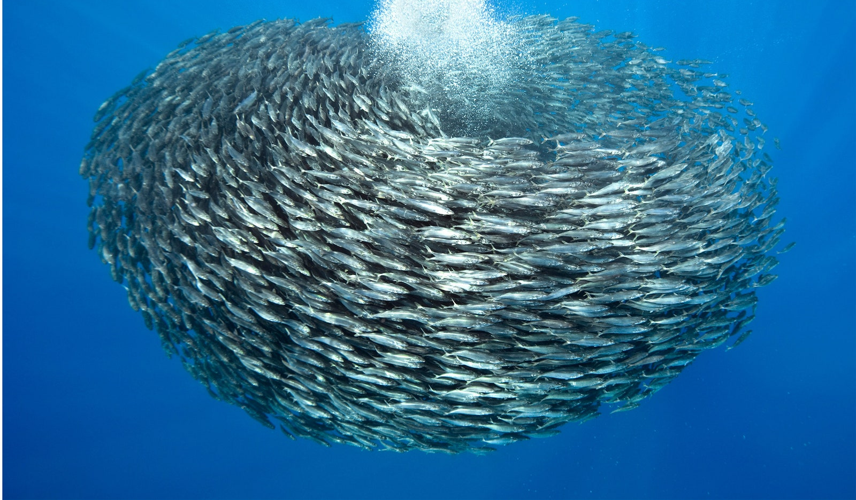
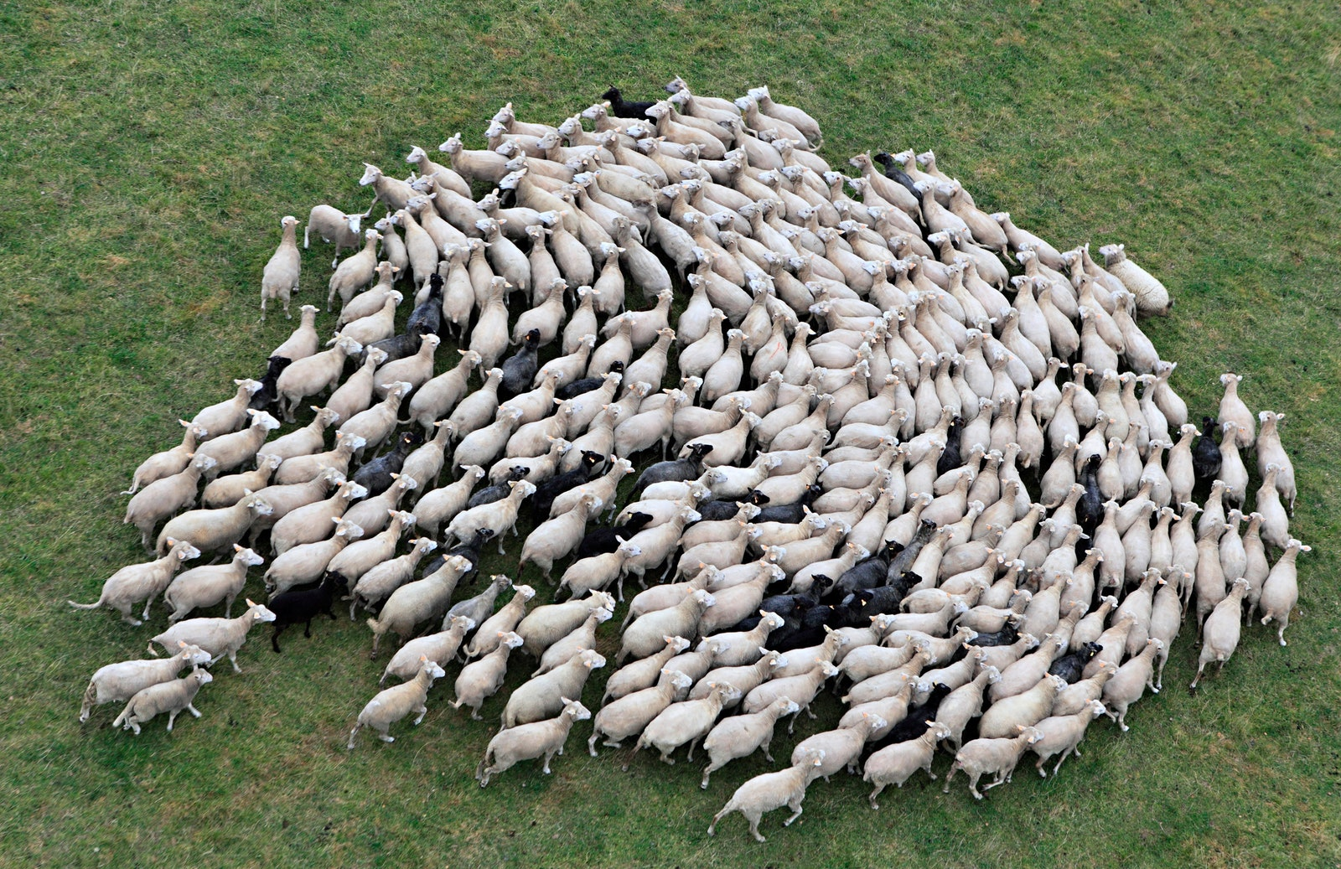
Milestone 4 (future)
- Add compute shader (for telling which boids are near each other)
- Implement a more animalistic flock formation (V-formation, torus, diamond, etc.)
- Add other formation options for the type of flock the boids will follow (fish, ants, locusts, etc.)

